Slide 1
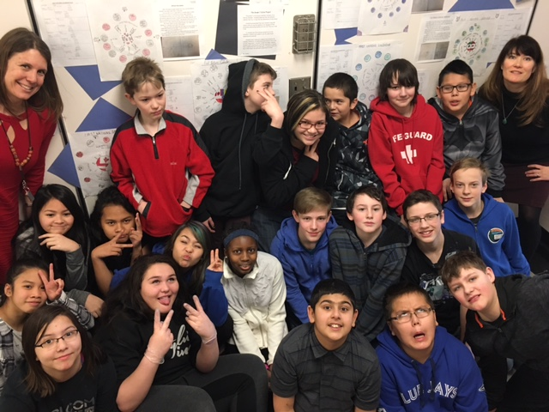
Making Learning Visible
A Growth Mindset, Collaboration and Doing
Trine Dennis
Selkirk Elementary

Slide 2
Scanning
A class with 25 students with diverse abilities
Many math students had not worked collaboratively before
The four questions allowed me to uncover who was not feeling confident in their math studies

Slide 3
Focus
My focus this year has been to observe how students might improve their learning and success in math when they work collaboratively in small groups or partnerships designing and completing projects using a growth mindset.

Slide 4
Hunch
My hunch is that in previous grades students worked independently with textbooks.

Slide 5
New Professional Learning
Learning Networks
Reading and implementing many of the strategies from Jo Boaler’s book “Mathematical Mindsets”
Chairing the intermediate PLC at my school with an emphasis on the book “Spirals of Inquiry”

Slide 6
Taking Action
Creating and designing projects with the students
Students taking an active role in the assessment of their work
Having the students work collaboratively on projects that are ”hands on”
Encouraging a growth mindset
Persevering and following through on each project with the students

Slide 7
Checking
Increase in understanding
Completed projects
Increased confidence
Richer and more positive answers from the four questions

Slide 8
Reflections
Students can learn math to a high level with a growth mindset, collaboration and opportunities to work on hands on projects
In the future, I am going to continue to teach the growth mindset, collaboration and design math projects with my students that encourage more hands on activities that connect their math to the real world

Slide 9
I've had the privilege of working in Trine's grade 7 math class with our students for the majority of the year. Her pedagogy is new, and very refreshing. I deeply appreciate her belief that with an open mindset, each child can go further than they may believe. I have seen that the students made shifts in their attitude, and have seen them experience success that definitely enhances their esteem and self concept.
Leslie Doran

Slide 10
Although people may differ in every which way— in their initial talents and aptitudes, interests, or temperaments—everyone can change and grow through application and experience.… The passion for stretching yourself and sticking to it, even (or especially) when it’s not going well, is the hallmark of the growth mindset. (Dweck 2006, 7)

